Slide 1

MAC Protocols for VANETs
Alexandru Oprea
Department of Computer Science
University of Freiburg
16th February 2010
Ad Hoc Networks Seminar
Alexandru Oprea
MAC Protocols for VANETs
16th February 2010

Slide 2
Based on:
Hamid Menouar and Fethi Filali, EURECOM
Massimiliano Lenardi, Hitachi Europe
A Survey and Qualitative Analysis of MAC Protocols for Vehicular Ad Hoc Networks
IEEE Wireless Communications, pages 30-35, October 2006.
Alexandru Oprea
MAC Protocols for VANETs
16th February 2010

Slide 3

Outline
What is a VANET?
Motivation
Introduction
Media access in MANETs
MAC Protocols for VANETs
Qualitative comparison
Conclusions
Alexandru Oprea
MAC Protocols for VANETs
16th February 2010

Slide 4
Outline
What is a VANET?
Motivation
Introduction
Media access in MANETs
MAC Protocols for VANETs
Qualitative comparison
Conclusions
Alexandru Oprea
MAC Protocols for VANETs
16th February 2010

Slide 5
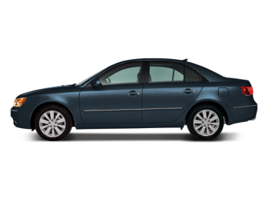
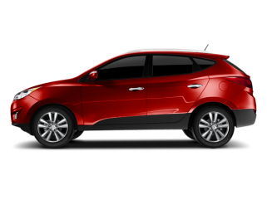
What is a VANET?
VANET stands for Vehicular Ad-hoc NETwork
a special type of MANETs (mobile ad-hoc networks) designed to provide communication between nearby vehicles and between vehicles and road-side equipment
Alexandru Oprea
MAC Protocols for VANETs
16th February 2010

Slide 6
Outline
What is a VANET?
Motivation
Introduction
Media access in MANETs
MAC Protocols for VANETs
Qualitative comparison
Conclusions
Alexandru Oprea
MAC Protocols for VANETs
16th February 2010

Slide 7

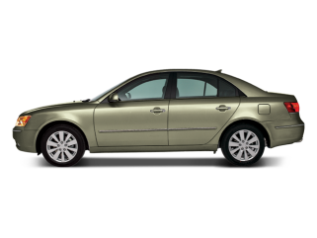
Motivation
Why are VANETs important?
Active Safety: send warning messages about dangerous traffic situations (an accident, icy road, oil stain, sudden break, etc.)
Alexandru Oprea
MAC Protocols for VANETs
16th February 2010
Notes:
Active Safety – VANETs can help to prevent car accidents
Traffic conditions – VANETs can help monitor the traffic and improve transport efficiency
Driving comfort – VANETs can provide driver assistance
In the Introduction to this Seminar, proffesor Schindelhauer stated that AdHoc Network are unknown to many people because there is no money to win form it. But in the area of VANETs the economical value can be very high.

Slide 8
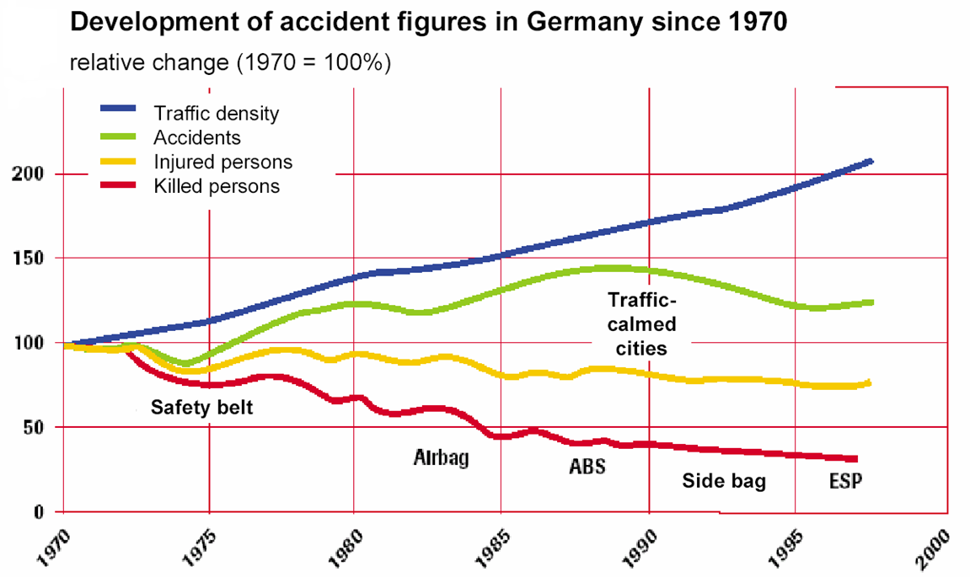
Motivation
Source: http://events.ccc.de/congress/2006/Fahrplan/attachments/1216-vanet.pdf
Alexandru Oprea
MAC Protocols for VANETs
16th February 2010

Slide 9
Motivation
And there is more:
traffic conditions
  improve traffic efficiency
  reduce traffic congestions
driving comfort
  driver assistance
  news/info/entertainment applications
economical reasons
  80% of innovation in new cars is electronics
  ABS & ESP Market: 3 billion € in 2010
  VANETs Market: estimated to reach 1 billion $ in 2012 [3]
Alexandru Oprea
MAC Protocols for VANETs
16th February 2010
Notes:
Active Safety – VANETs can help to prevent car accidents
Traffic conditions – VANETs can help monitor the traffic and improve transport efficiency
Driving comfort – VANETs can provide driver assistance
In the Introduction to this Seminar, proffesor Schindelhauer stated that AdHoc Network are unknown to many people because there is no money to win form it. But in the area of VANETs the economical value can be very high.

Slide 10
Outline
What is a VANET?
Motivation
Introduction
Media access in MANETs
MAC Protocols for VANETs
Qualitative comparison
Conclusions
Alexandru Oprea
MAC Protocols for VANETs
16th February 2010

Slide 11
Introduction
Properties of VANETs:
decentralized
self-organizing
network nodes = cars
MANETs
Alexandru Oprea
MAC Protocols for VANETs
16th February 2010

Slide 12
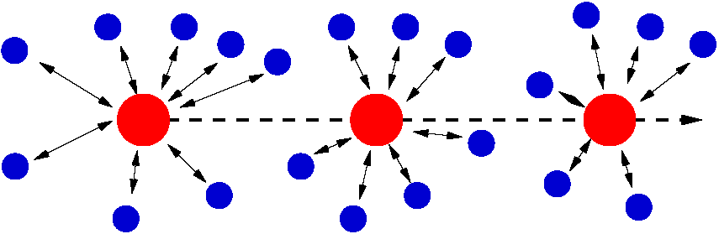
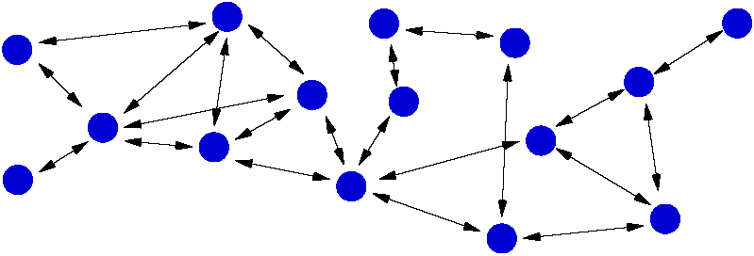


Introduction
Cellular Networks
- mobile
- centralized
MANETs
- mobile
- decentralized
VANETs
- mobile
decentralized
nodes = cars
Source: http://petsymposium.org/2005/workshop/talks/VANET-privacy-final-official.ppt
Alexandru Oprea
MAC Protocols for VANETs
16th February 2010

Slide 13
Introduction
Differences to MANETs:
restricted mobility (highways and roads)
fast topology changes (network nodes move at high speeds)
no power and storage limitations
nodes are aware of their position (via GPS)
Requirements:
high reliability
low latency
eg. Vehicle Infrastructure Integration (VII) from the US: information about an accident should be communicated within half a second to all vehicles in 500m range.
Alexandru Oprea
MAC Protocols for VANETs
16th February 2010

Slide 14
Outline
What is a VANET?
Motivation
Introduction
Media access in MANETs
MAC Protocols for VANETs
Qualitative comparison
Conclusions
Alexandru Oprea
MAC Protocols for VANETs
16th February 2010

Slide 15
Media access in MANETs
Major problems
transmission collisions
hidden terminal problem
exposed terminal problem
Alexandru Oprea
MAC Protocols for VANETs
16th February 2010

Slide 16
Media access in MANETs
Transmission collisions
shared communication medium
two terminals (A,B) try to transmit at the same time to a third terminal (C)
solution: terminals should be aware of ongoing transmissions
A
B
C
Alexandru Oprea
MAC Protocols for VANETs
16th February 2010

Slide 17
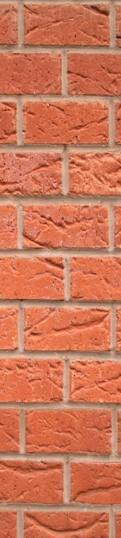
Media access in MANETs
Hidden terminal problem
terminals could be hidden from each other
C
A
B
Alexandru Oprea
MAC Protocols for VANETs
16th February 2010

Slide 18
Media access in MANETs
Exposed terminal problem
a node (S2) is prevented from sending packets to other nodes (R2) due to a neighboring transmitter.
R1
S1
S2
R2
Alexandru Oprea
MAC Protocols for VANETs
16th February 2010

Slide 19
Outline
What is a VANET?
Motivation
Introduction
Media access in MANETs
MAC Protocols for VANETs
Qualitative comparison
Conclusions
Alexandru Oprea
MAC Protocols for VANETs
16th February 2010

Slide 20
MAC Protocols for VANETs
Advantages of VANETs over MANETs:
restricted mobility (highways and roads)
no power and storage limitations
nodes are aware of their position (via GPS)
Disadvantages:
fast topology changes (network nodes move at high speeds)
Requirements for VANETs:
reliable communication
small latency
Alexandru Oprea
MAC Protocols for VANETs
16th February 2010
Notes:
A good MAC protocol should use these advantages.

Slide 21
MAC Protocols for VANETs
Proposed MAC Protocols:
IEEE 802.11 Standard
ADHOC MAC
Directional antenna – based MAC protocols
Alexandru Oprea
MAC Protocols for VANETs
16th February 2010

Slide 22
MAC Protocols for VANETs
Proposed MAC Protocols:
IEEE 802.11 Standard
ADHOC MAC
Directional antenna – based MAC protocols
Alexandru Oprea
MAC Protocols for VANETs
16th February 2010

Slide 23
MAC Protocols for VANETs – IEEE 802.11
The IEEE 802.11 Standard
addresses both the MAC and the Physical Layer
widely accepted by the network community
IEEE 802.11 MAC
medium access: Distributed Coordination Function (DCF) based on Carrier Sense Multiple Access with Collision Avoidance (CSMA/CA)
To solve the hidden terminal problem: virtual carrier sensing using a Network Allocation Vector (NAV)
Alexandru Oprea
MAC Protocols for VANETs
16th February 2010

Slide 24
MAC Protocols for VANETs – IEEE 802.11
IEEE 802.11 MAC
Neighbor1
Sender
Receiver
Neighbor 2
RTS
RTS
CTS
CTS
DATA
ACK
RTS (Request To Send)
CTS (Clear To Send)
ACK (Acknowledge)
Alexandru Oprea
MAC Protocols for VANETs
16th February 2010

Slide 25
MAC Protocols for VANETs – IEEE 802.11
IEEE 802.11 MAC
Inter Frame Spaces (IFS) are important
SIFS < DIFS
Sender
RTS
DATA
Receiver
CTS
ACK
Neighbor 1
NAV (RTS)
Neighbor 2
NAV (CTS)
Distributed IFS (DIFS)
Short IFS (SIFS)
Alexandru Oprea
MAC Protocols for VANETs
16th February 2010
Notes:
SIFS = is calculated in such way that the transmitting station is able to switch back to receiver mode
DIFS = used for a station willing to start transmission

Slide 26
MAC Protocols for VANETs – IEEE 802.11
IEEE 802.11p WAVE (Wireless Access in Vehicular Environments)
an amendment to all IEEE 802.11 protocols
main goal: adapt the IEEE 802.11 standard for inter-vehicular communications (low latency and high reliability)
scheduled to be published in November 2010 (according to the official IEEE 802.11 Working Group project timelines)
Alexandru Oprea
MAC Protocols for VANETs
16th February 2010
Notes:
IEEE 802.11p is not a standalone standard. It is intended to amend the overall IEEE 802.11 standard

Slide 27
MAC Protocols for VANETs – IEEE 802.11
IEEE 802.11 PHY (Physical) Layer
Name | Year | Band (GHz) | Throughput (Mbps)
802.11a | 1999 | 5 | 54
802.11b | 1999 | 2.4 | 11
802.11g | 2003 | 2.4 | 54
802.11n | 2009 | 2.4/5 | 600
Alexandru Oprea
MAC Protocols for VANETs
16th February 2010

Slide 28
MAC Protocols for VANETs
Proposed MAC Protocols:
IEEE 802.11 Standard
ADHOC MAC
Directional antenna – based MAC protocols
Alexandru Oprea
MAC Protocols for VANETs
16th February 2010

Slide 29
MAC Protocols for VANETs – ADHOC MAC
ADHOC MAC
based on a circuit switching method: Time Division Multiple Access (TDMA)
uses UMTS Terrestrial Radio Access Time Division Duplex (UTRA-TDD) as PHY Layer
uses the Reliable Reservation ALOHA (RR-ALOHA) protocol:
  the medium is divided into several repeated time frames
  each frame is divided into N time slots
  each terminal selects and emits only on one repeated time slot, called basic channel (BCH)
  frame information (FI) vectors are used to avoid the hidden terminal problem
Alexandru Oprea
MAC Protocols for VANETs
16th February 2010
Notes:
IEEE 802.11p is not a standalone standard. It is intended to amend the overall IEEE 802.11 standard

Slide 30
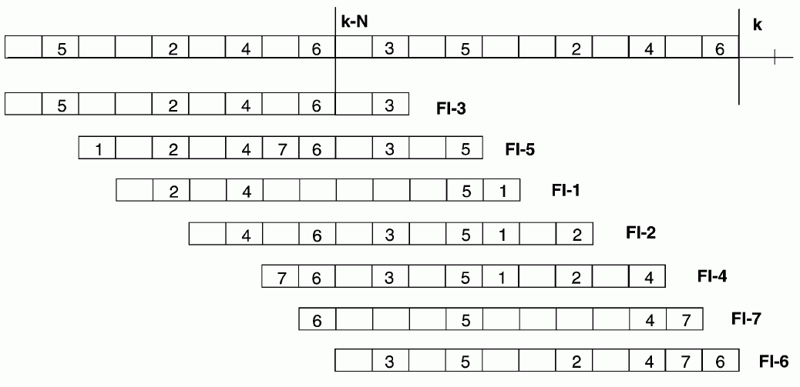
MAC Protocols for VANETs – ADHOC MAC
3
2
6
4
5
1
7
Source: [5]
Alexandru Oprea
MAC Protocols for VANETs
16th February 2010
Notes:
IEEE 802.11p is not a standalone standard. It is intended to amend the overall IEEE 802.11 standard

Slide 31
MAC Protocols for VANETs
Proposed MAC Protocols:
IEEE 802.11 Standard
ADHOC MAC
Directional antenna – based MAC protocols
Alexandru Oprea
MAC Protocols for VANETs
16th February 2010

Slide 32
MAC Protocols for VANETs – Directional antennas
Directional antennas-based MAC protocols
increase the coverage and special reuse, therefore leading to greater channel capacity
can be a good solution for VANETs because cars move only on roads
Alexandru Oprea
MAC Protocols for VANETs
16th February 2010
Notes:
IEEE 802.11p is not a standalone standard. It is intended to amend the overall IEEE 802.11 standard

Slide 33
MAC Protocols for VANETs – Directional antennas
Directional MAC (D-MAC)
each terminal must know its geographic position (easy via GPS)
Based on IEEE 802.11, uses a 4 way handshake
RTS
CTS
DS
ACK
Alexandru Oprea
MAC Protocols for VANETs
16th February 2010
Notes:
IEEE 802.11p is not a standalone standard. It is intended to amend the overall IEEE 802.11 standard

Slide 34
Outline
What is a VANET?
Motivation
Introduction
Media access in MANETs
MAC Protocols for VANETs
Qualitative comparison
Conclusions
Alexandru Oprea
MAC Protocols for VANETs
16th February 2010

Slide 35
Qualitative comparison
 | 802.11 MAC | ADHOC MAC | D-MAC
Based on | CSMA/CA | RR-ALOHA | CSMA/CA
Implementation maturity | Mature and evolving | Medium | Low
QoS and RT capability | Small | Medium | High
Mobility | Medium evolving to High | Medium | High
Reliability multicast/broadcast | No | Yes | No
Time synchronization | Not needed | Mandatory | Not needed
IEEE 802.11p could represent a real solution, but waits to be published
Directional antennas offer high reliability and low latency, but are too complex and hard to manage in real implementations
Alexandru Oprea
MAC Protocols for VANETs
16th February 2010
Notes:
802.11 > ADHOC MAC : it can handle better high mobility and does not need time sync. The 802.11p amendment could represent a real solution, but was not yet published
ADHOC MAC > 802.11 : better QoS and RT capability, reliable transmissions in a two hop neighborhood; Problems when the number of vehicles in the same area is grater then the number of time slots
Directional Antennas : could be a real solution for VANETs, but are “too complex and hard to manage in real implementations”

Slide 36
Outline
What is a VANET?
Motivation
Introduction
Media access in MANETs
MAC Protocols for VANETs
Qualitative comparison
Conclusions
Alexandru Oprea
MAC Protocols for VANETs
16th February 2010

Slide 37
Conclusions
VANETs have many practical applications, but the most important ones are in terms of active safety
there are no standardized protocols, but a lot of research is done in this area (http://www.vanet.info/projects)
VANETs are likely to become the most important realization of mobile ad hoc networks
what about security?
Alexandru Oprea
MAC Protocols for VANETs
16th February 2010

Slide 38
References
1. Hamid Menouar and Fethi Filali, EURECOM
Massimiliano Lenardi, Hitachi Europe
A Survey and Qualitative Analysis of MAC Protocols for Vehicular Ad Hoc Networks
IEEE Wireless Communications, pages 30-35, October 2006.
2. Florian Dötzer, BMW Group Research and Technology
Privacy Issues in Vehicular Ad Hoc Networks
Workshop on Privacy Enhancing Technologies, Dubrovnik, June 2005
3. Maged Hamada Ibrahim,
Noninteractive, Anonymously Authenticated, and Traceable Message Transmission for VANETs
International Journal of Vehicular Technology, vol. 2009, Article ID 702346
4. Andrew S. Tanenbaum
Reţele de calculatoare
Byblos, 4th Edition, 2004, pages 270-271
Alexandru Oprea
MAC Protocols for VANETs
16th February 2010

Slide 39
References
5. F. Borgonovo, A. Capone, M. Cesena and L. Fratta, Politecnico di Milano
ADHOC MAC: New MAC Architecture for Ad Hoc Networks Providing Efficient and Reliable Point-to-Point and Broadcast Services
Wireless Networks, 10, pages 359-366, July 2004.
Alexandru Oprea
MAC Protocols for VANETs
16th February 2010

Slide 40
Conclusions
Thank you for your attention!
Alexandru Oprea
MAC Protocols for VANETs
16th February 2010

